Slide 1

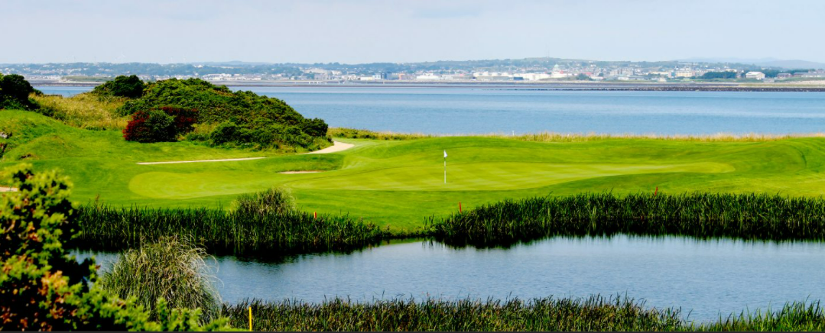


One day fun day outing in Ireland
CS621 Project
Submitted by-
Sanya Chawla, 21250183

Slide 2
Introduction
Ireland is home to the kind of beauty that will instantly make you a believer.
In Ireland, there are many beautiful and serene places to visit.
The project outlays a one-day outing in Ireland.
The county to visit, nearby restaurants and the activity place is finalized based on some predefined conditions using POSTGIS and QGIS.

Slide 3
Motivation and Assumptions
I came to Ireland in September 2021 for pursuing Masters course and have not explored many places yet. Thus, I thought of planning a day out in Ireland with my friends.
Assumptions/conditions taken while analyzing the results:
Few of my friends prefer vegetarian over non-vegetarian, thus the county to visit has been finalized taking into consideration that the county has decent number of restaurants that are vegetarian friendly. I have taken minimum 300 vegetarian friendly restaurants in a county as threshold. Also, since I reside in Dublin and few of my friends in Cork. Thus, we decided to explore county other than these two.
(Assumption made after county has been finalized) Our plan for outing: Visit to Galway Bay in the morning followed by brunch in a restaurant. Some activity after brunch. At last, visit to Galway City Museum followed by dinner in a restaurant.

Slide 4
Motivation and Assumptions (Contd..)
The restaurant that we will visit for brunch should be within 1 km radius of Galway Bay and should serve Italian cuisine. The other restaurant that we will visit for dinner should be within 500 meters radius of Galway City Museum and should serve Indian cuisine. Both the restaurants should have minimum of 4.5 average rating with maximum number of excellent ratings.
The activity to be done is Kayaking and the place should be the nearest one within 8 kms of the restaurant where we will have brunch.

Slide 5
Spatial Data Sources
Administrative Boundary of Ireland:
• source: http://www.diva-gis.org/gdata
• format: shapefile [EPSG:4326]
Kaggle: European Restaurants
• Source: https://www.kaggle.com/stefanoleone992/tripadvisor-european-restaurants-eda/data
• Format: CSV file [EPSG: 4326]
Government of Ireland: Activities
• Source: https://data.gov.ie/dataset/activities?package_type=dataset
• Format: CSV file [EPSG: 4326]

Slide 6
Data Cleaning
The dataset of restaurants in all the European countries was provided. I have filtered the dataset for only Ireland.
The columns that were not required in the analysis, for example original_open_hours, default_language, awards (awards given to the restaurant(if any)) and many more were removed.
Longitude and Latitude columns were checked for the datasets European restaurants and activities. The rows for which longitude or latitude was not provided were removed from the CSV files.

Slide 7
Analysis
We will perform following analysis and draw conclusions.
Select county for day-outing based on the number of vegetarian friendly restaurants in each county.
Vegetarian friendly restaurants within 1 km radius of Galway Bay.
Selecting restaurant for brunch based on additional filters of average rating of the restaurant, cuisine and maximum number of excellent reviews.
Place for activity (Kayaking) that is within 8 kms radius of restaurant where we will have brunch.
Vegetarian friendly restaurants within 500 meters of Galway City Museum.
Selecting restaurant for dinner based on additional filters of average rating of the restaurant, cuisine and maximum number of excellent reviews.

Slide 8
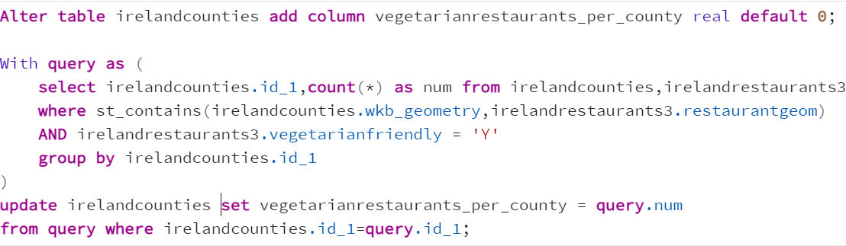
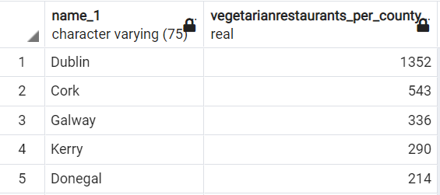
Vegetarian restaurants in each county: Choropleth Map
“Point in Polygon” analysis has been done to find out the number of vegetarian restaurants in each county.
Top 5 counties in terms of number of vegetarian restaurants

Slide 9
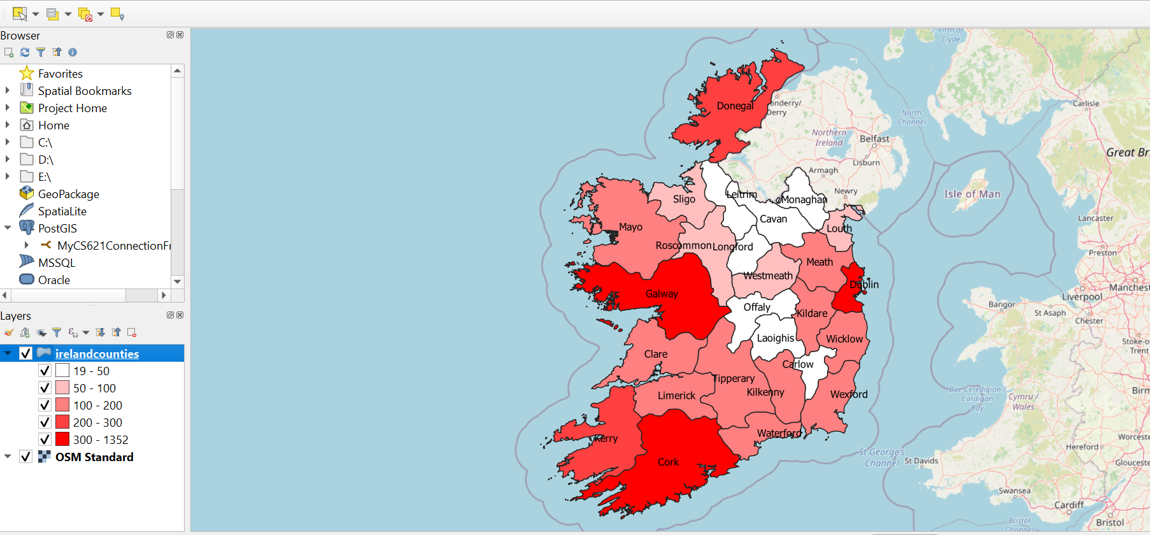
Database DB Manager POSTGIS. Select the assigned schema and then look for irelandcounties table and click add to canvas. Classify the range as per the number of vegetarian restaurants in each county.

Slide 10
It’s Galway…
The three counties with more than 300 vegetarian friendly restaurants are Dublin, Cork, and Galway.
I stay in Dublin and few of my friends in Cork. Thus, we will go for outing to Galway.

Slide 11
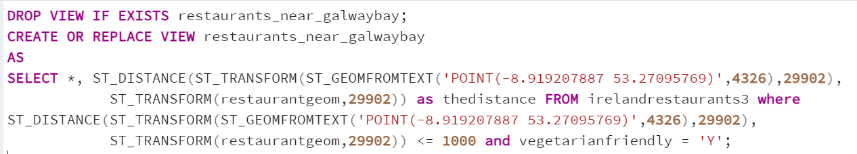
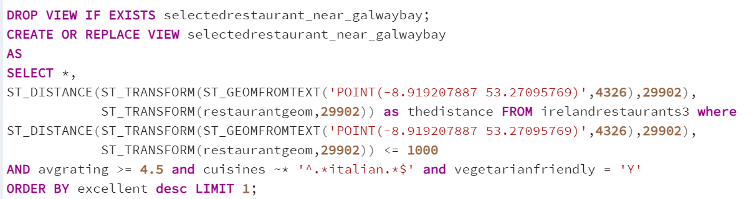
Restaurant for Brunch Galway Bay Location: Lon: -8.919207887 Lat: 53.27095769
Created a query in PostgreSQL that will filter the restaurants within 1 km radius of Galway Bay and stored the query in a view.
Another view has been created with further filters of Italian cuisine, average rating of minimum 4.5 with maximum excellent ratings to specify the restaurant that has been selected for brunch.

Slide 12
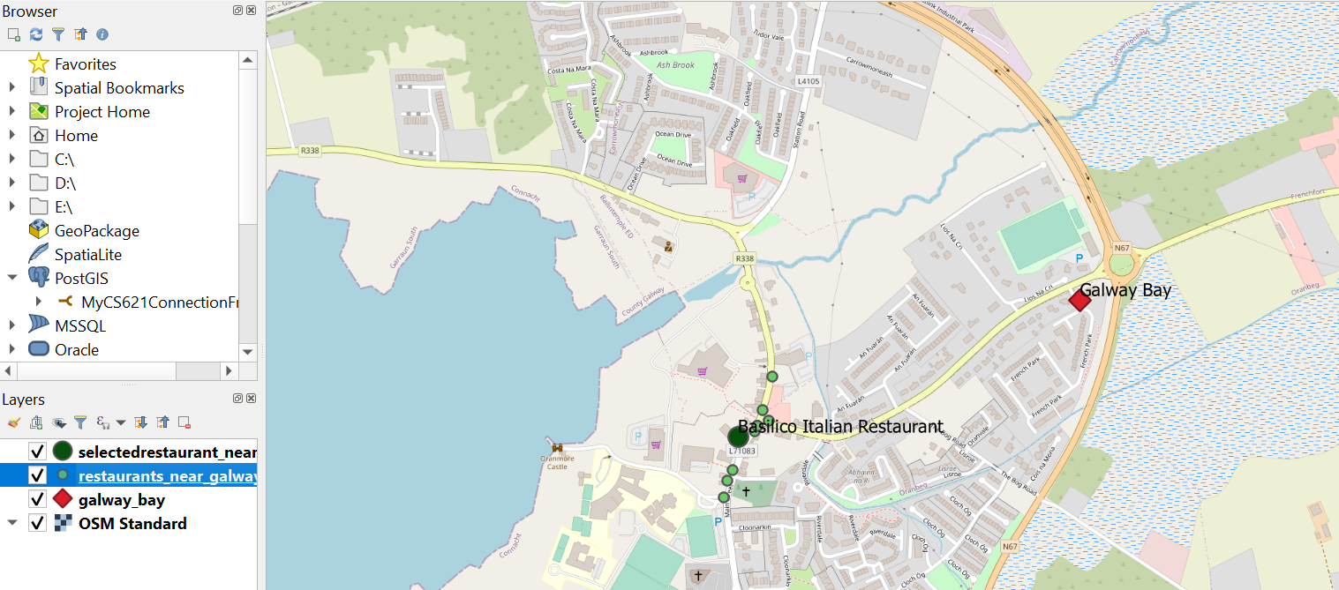
Visualization in QGIS
There are a total of 12 vegetarian friendly restaurants within 1 km radius of Galway Bay. After applying additional filters of average rating, cuisine and maximum excellent reviews, our search narrowed down to Basilico Italian Restaurant.

Slide 13
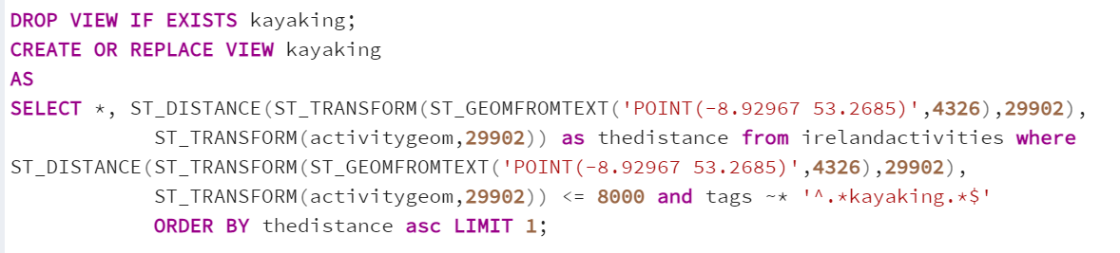
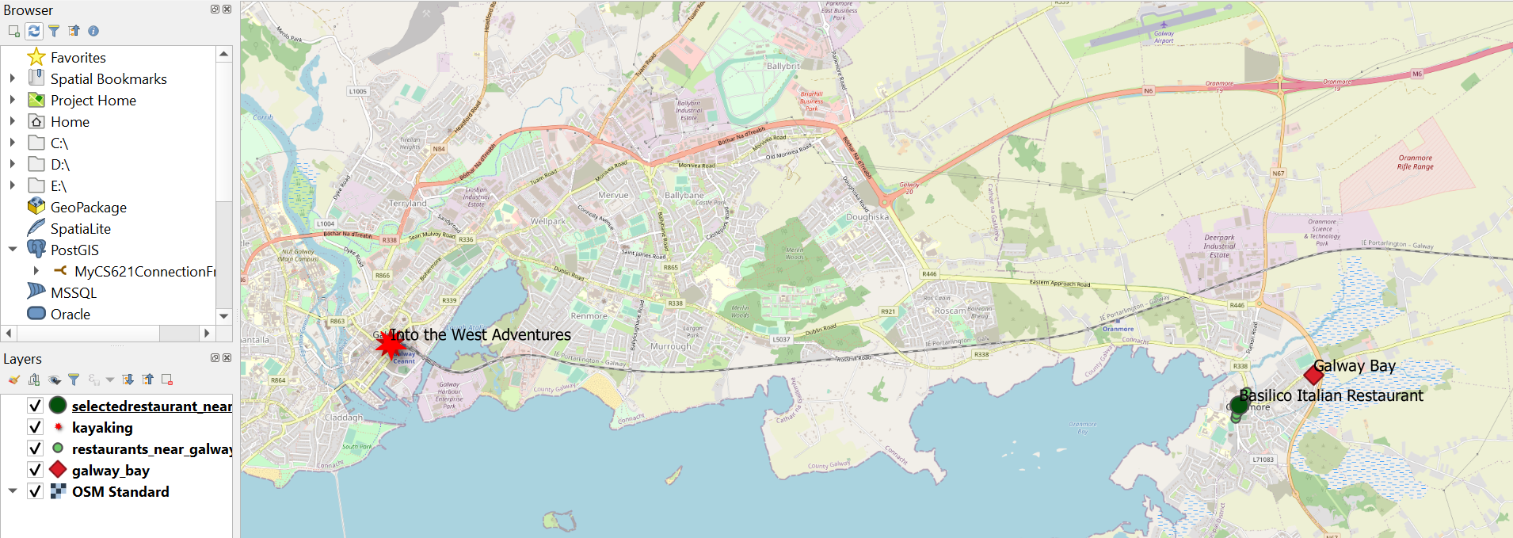
Place for Activity
The query is written in POSTGIS to find the nearest place that is within 8 kms radius of Basilico Italian Restaurant that offers Kayaking. The query was stored as a view for visualization in QGIS.
The place of activity is “Into the West Adventures”.

Slide 14
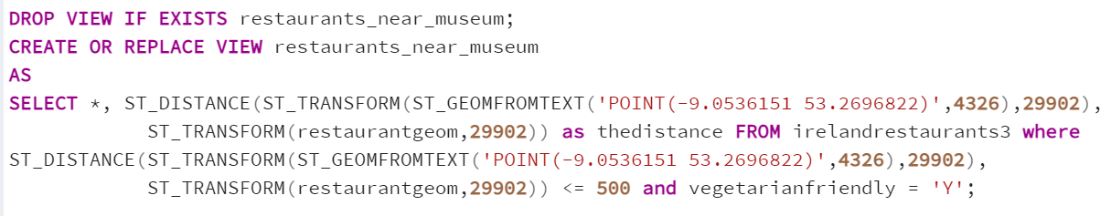
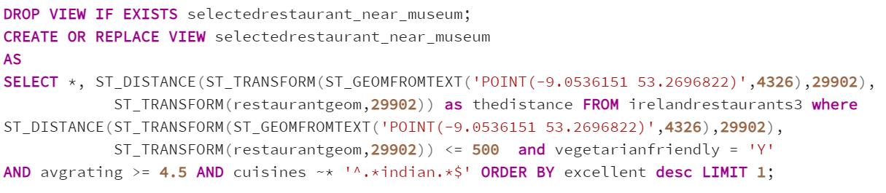
Restaurant for dinner Galway City Museum Location: Lon: -9.0536151 Lat: 53.2696822
Created a query in PostgreSQL that will filter the restaurants within 500 meters radius of Galway City Museum and stored the query in a view.
Another view has been created with further filters of Indian cuisine, average rating of minimum 4.5 with maximum excellent ratings to specify the restaurant that has been selected for dinner.

Slide 15
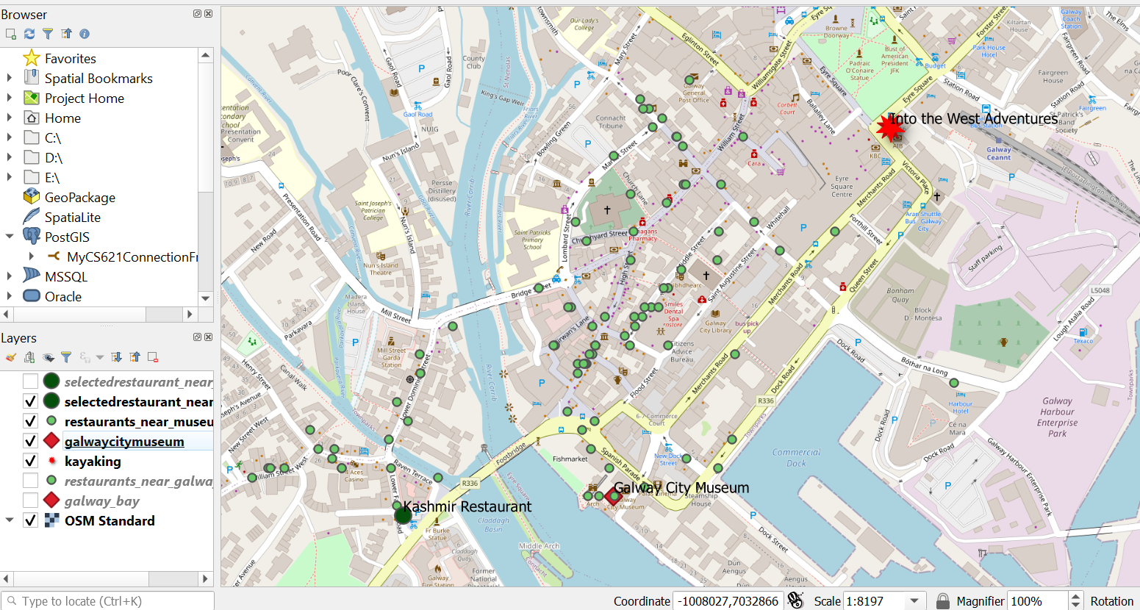
Visualization in QGIS
There are a total of 89 vegetarian friendly restaurants within 500 meters radius of Galway City Museum. After applying additional filters of average rating, cuisine and maximum excellent reviews, our search narrowed down to Kashmir Restaurant.

Slide 16
Conclusion
The distribution of restaurants that offer vegetarian as well along with non-vegetarian is shown using the Choropleth Map. Dublin is the county that has maximum number of vegetarian restaurants followed by Cork and Galway.
Restaurants for brunch and dinner were selected based on our preferences and the map visualization has been done in QGIS.
The place for activity (Kayaking) is also selected and the map visualization has been done in QGIS.

Slide 17
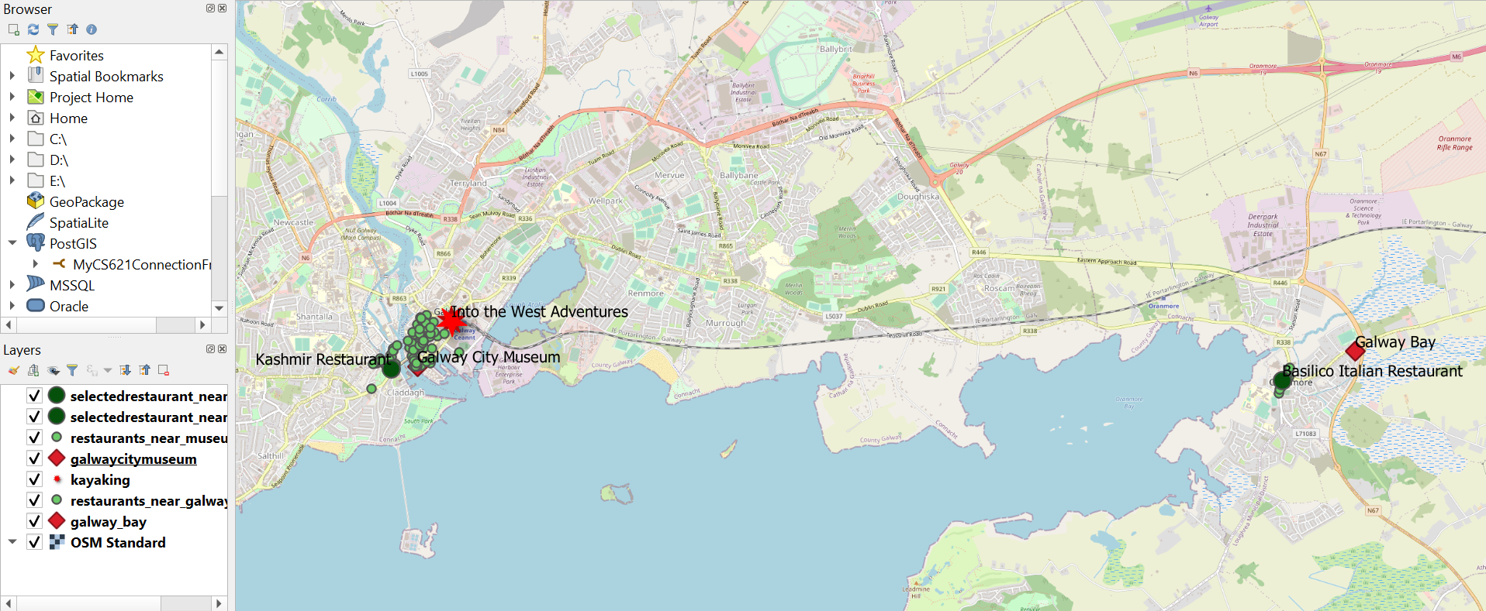
QGIS: Map containing all layers

Slide 18
Map legends
Small Light Green Points: Restaurants that lie within the specified range
Large Dark Green Points: Restaurants selected for brunch and dinner, that is Basilico Italian Restaurant and Kashmir Restaurant.
Red Diamonds: Places to be visited under assumption, that is, Galway Bay and Galway City Museum.
Red Star: Place for Activity, that is, Into the West Adventures.

Slide 19
THANK YOU

